Slide 1


roomWeather
Gambari Gianluca
Lucchini Gianmaria

Slide 2

roomWeather
Gambari Gianluca
Lucchini Gianmaria

Slide 3
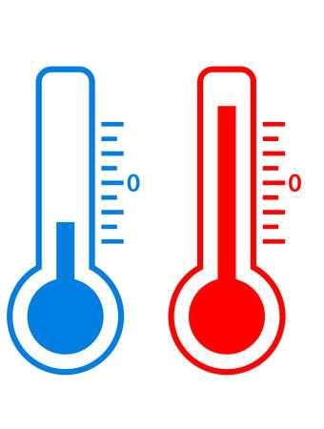
Our goals:
REAL - TIME VALUES
Measure temperature and humidity for each available room
VIEW STATS
Display live values
HISTORY
Show the daily stats given a specific day

Slide 4






Overview

Slide 5
1.
Technologies

Slide 6
Server-Side
Node.js
Express.js
Socket.IO

Slide 7



Back-end
Node.js
Node.js is an open-source, cross-platform JavaScript run-time environment that executes JavaScript code outside of a browser.
Express.js
Express is a minimal and flexible Node.js web application framework that provides a robust set of features for web and mobile applications.
Socket.IO
Socket.IO enables real-time, bidirectional and event-based communication.It works on every platform, browser or device, focusing equally on reliability and speed.

Slide 8
Database
Mongo DB
Mongoose

Slide 9


Database
Mongo DB
MongoDB is an open-source document database that provides high performance, high availability, and automatic scaling.
Mogoose
Mongoose provides a straight-forward, schema-based solution to model your application data.

Slide 10
Client - Side
d3.js
Javascript
Bootstrap

Slide 11


Front-end
Javascript
Bootstrap
D3.js
D3.js (or just D3 for Data-Driven Documents) is a JavaScript library for producing dynamic, interactive data visualizations in web browsers.

Slide 12

Mobile App
React Native
ART

Slide 13

Mobile App
React Native
React Native is a JavaScript framework for writing real, natively rendering mobile applications for iOS and Android.
ART
ART a built in library for simple vector drawing
ART

Slide 14

Raspberry Pi
SenseHat
DHT11

Slide 15
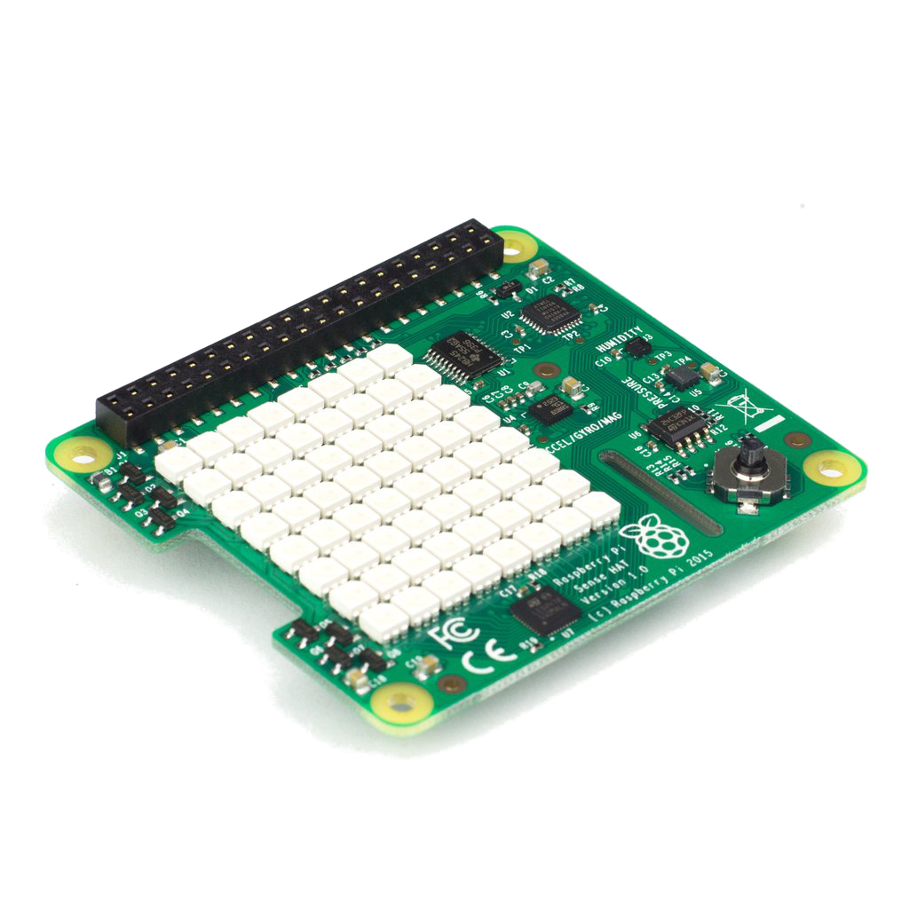
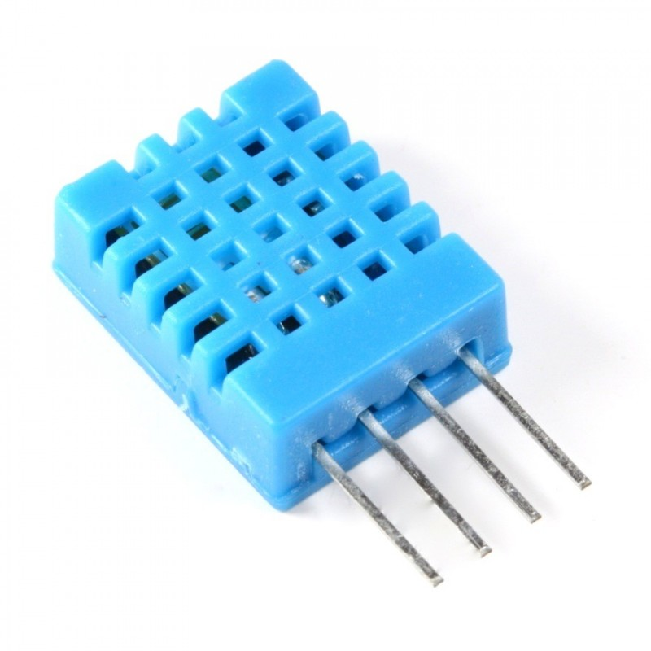

Raspberry Pi
SenseHat
The Sense HAT is an add-on board for the Raspberry Pi. The board allows you to make measurements of temperature, humidity, pressure, and orientation, and to output information using its built-in LED matrix.
DHT11
The DHT11 is a basic, ultra low-cost digital temperature and humidity sensor. It uses a capacitive humidity sensor and a thermistor to measure the surrounding air, and spits out a digital signal on the data pin.

Slide 16
2.
Desktop
Application

Slide 17

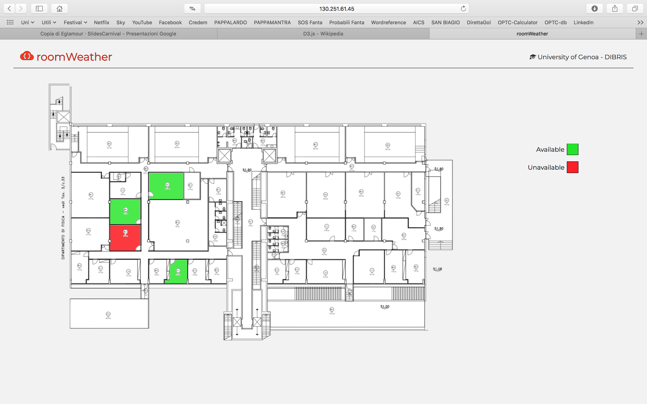
Desktop view

Slide 18
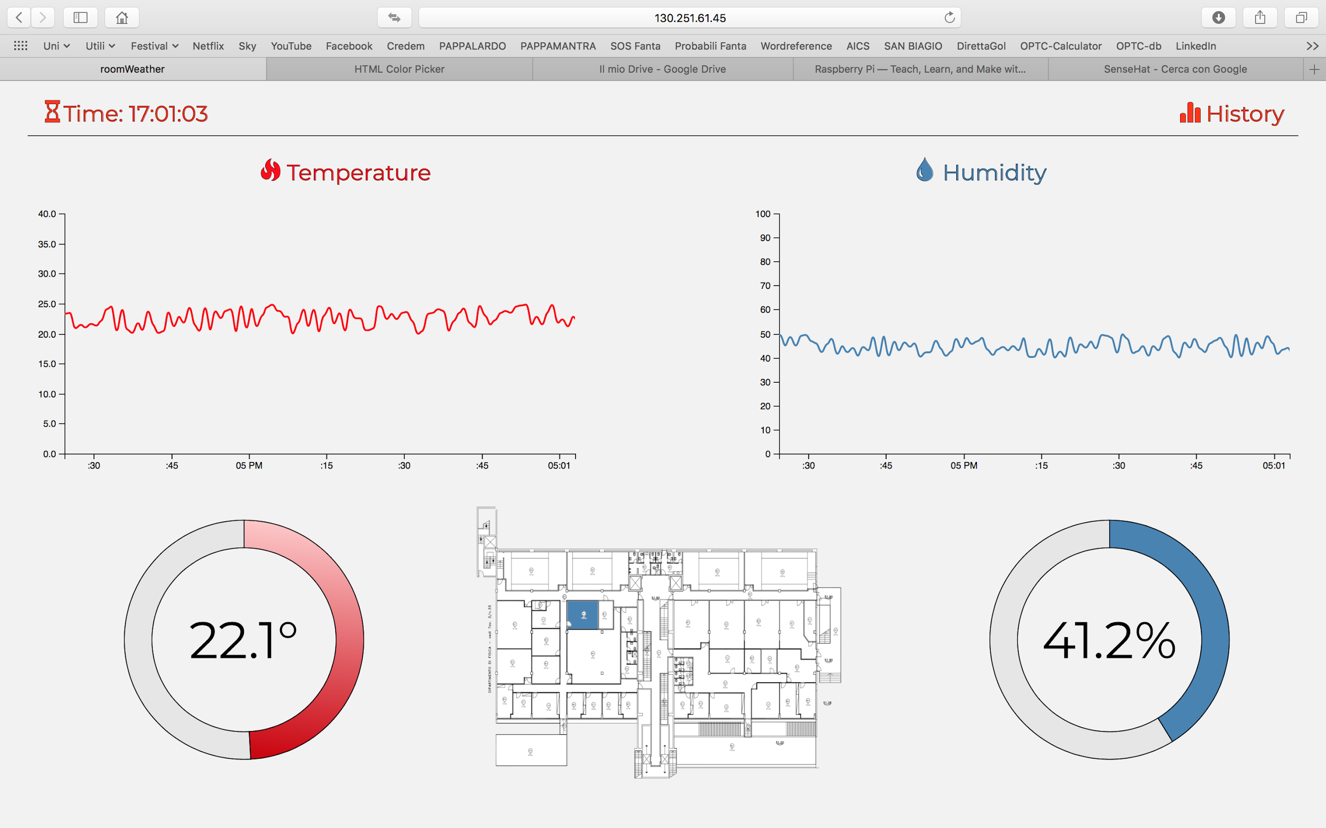
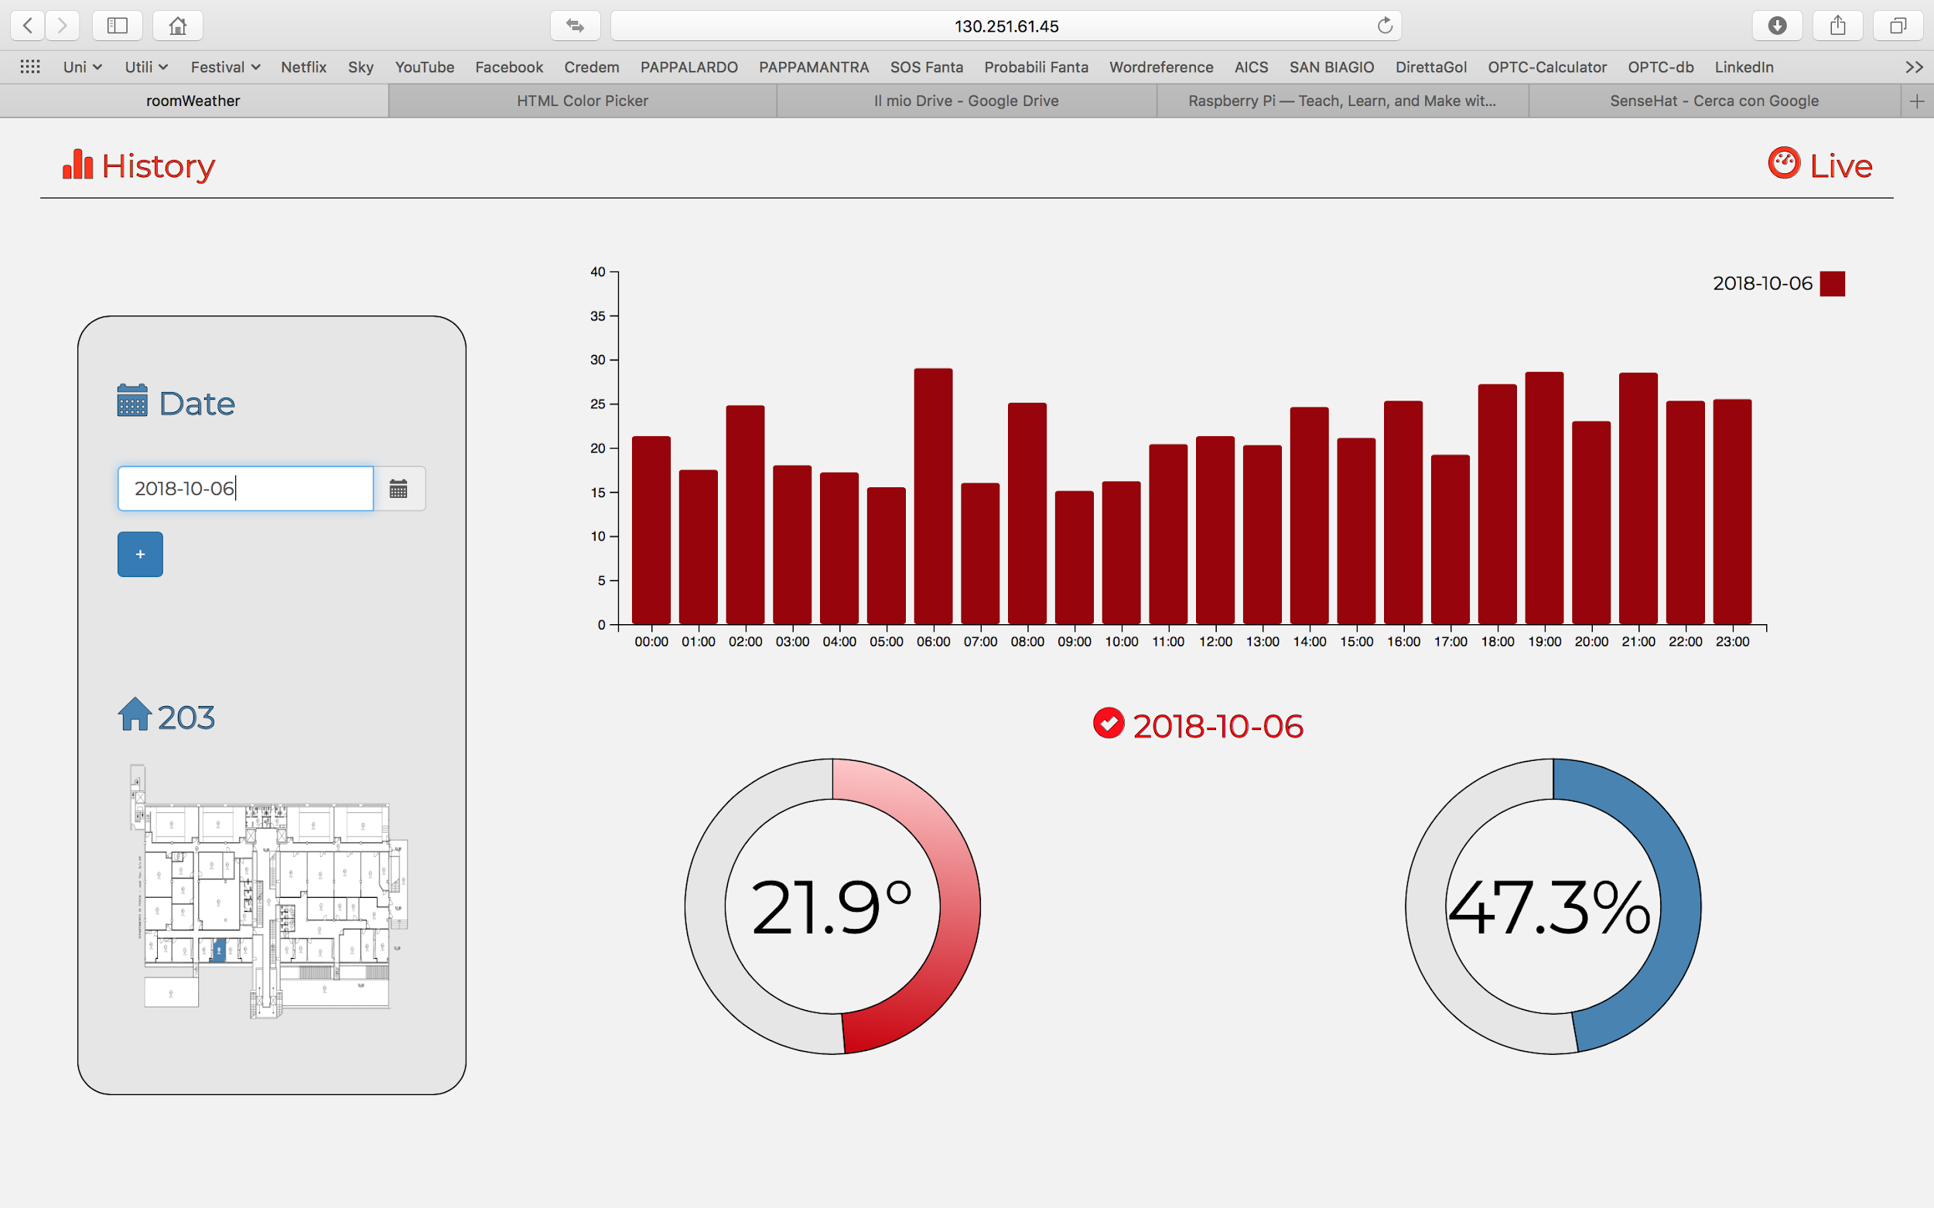

Slide 19
3.
App

Slide 20

Mobile view

Slide 21
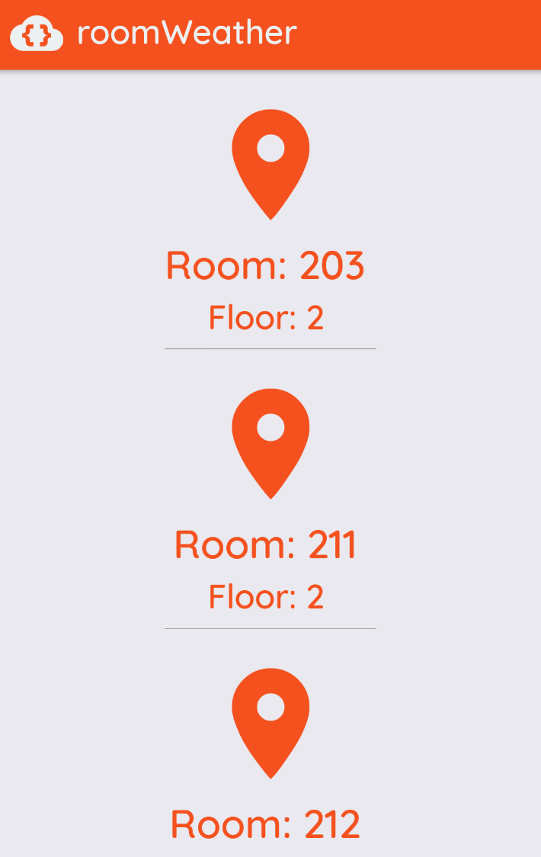
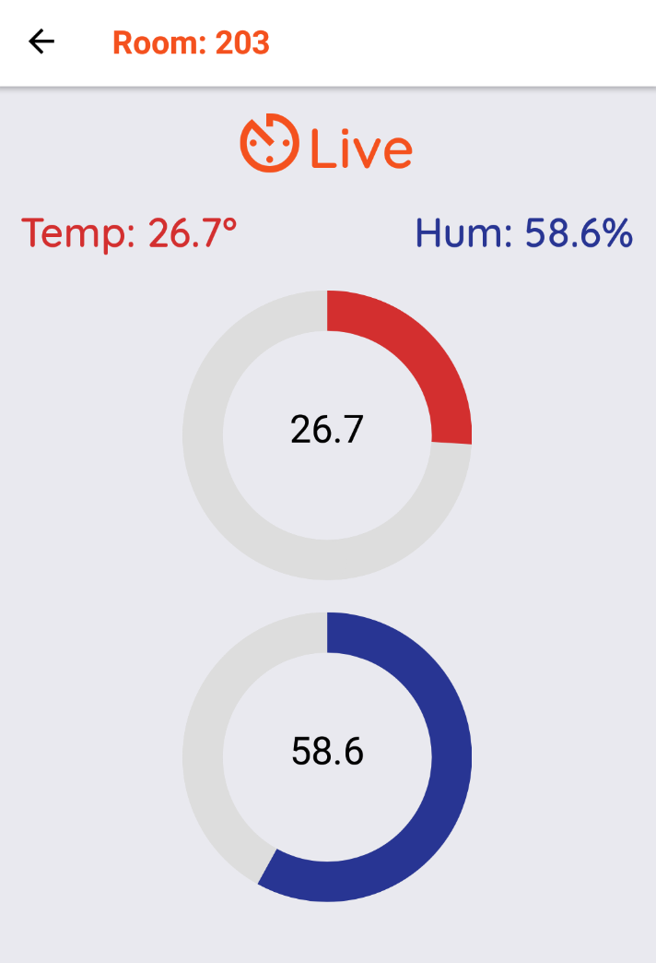
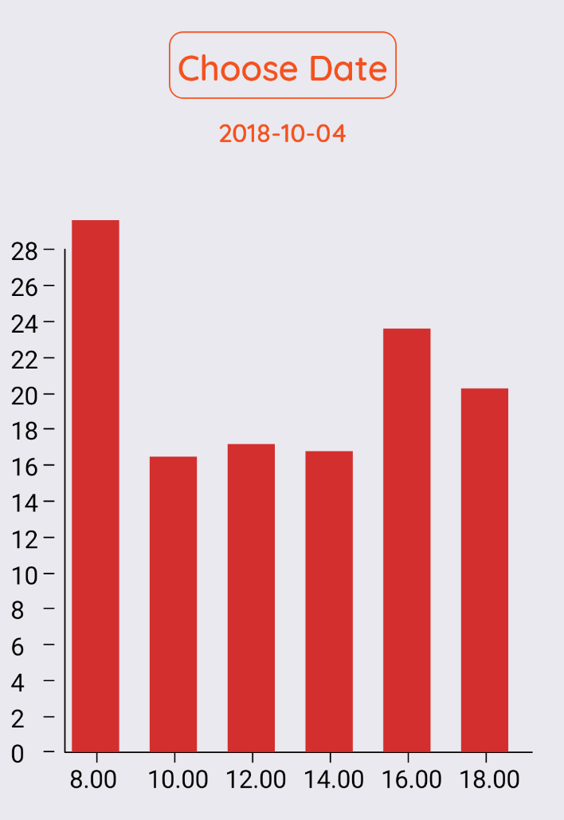

Slide 22
4.
Future improvements

Slide 23
Possible improvements
Login
Favorite rooms
Analytics
ESP8266 hardware instead of Raspberry Pi
DHT22 sensor instead of DHT11

Slide 24
THANK YOU

